Slide 1
Face Authentication based Attendance System
Name :- Piyush Kumar
Entry Number :- 23bcs061
Semester:-5th
Department:-Computer science engineering
Guide Name:-Dr. Rohit Tanwar sir

Slide 2
Problem Statement
Devlop a facial authentication based attendance system that records attendance in a CSV file and sends email for attendance confirmations to ensure accurate, efficient , and paperless attendance management.
Objectives
The main objective of this project is to overcome Traditional attendance systems that rely on manual entry or physical identification. By developing a facial recognition-based attendance management system that can detect and identify faces in real-time, and mark the attendance in a CSV file also send email for attendance confirmation to ensure accuracy, security, time efficiency, and prevention of proxy attendance.
.

Slide 3
Proposed Methodology
Image Acquisition:
Capture student images through a webcam in real-time.
Grayscale Conversion:
Converts RGB image to grayscale to reduce computational complexity while retaining
important features.
Face Detection:
Use algorithms like Haar Cascade detectors to locate faces in the frame.
Feature Extraction:
Extract face data from resized images and store it in a pickle file.

Slide 4
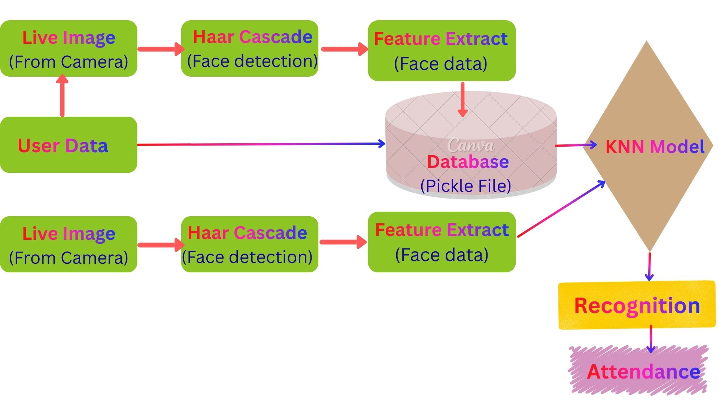
Model Training and Recognition:
For this purpose I use KNN algorithm to train the model. And use it to predict incoming
frame with the help of this trained model.
Attendance marking and Confirmation:
If authentication succeeds, it mark the attendance in the system as CSV file.
And send email for attendance confirmation.

Slide 5
Technologies and Tools used
A. Programming Language:
1. Python: Most commonly used language for computer vision and machine learning
tasks.
B. Libraries and Modules:
1.OpenCV: An open-source computer vision library often used for image processing and face detection tasks.
2.pickle: pickle is a standard Python module for serializing and deserializing Python objects.
3. OS: The OS module provides a way to interact with the operating system.
4.numpy: numpy is a fundamental package for numerical computing in Python.
5. Scikit-learn: Scikit-learn is also an open-source Python library usually used for machine learning task for providing algorithms to train and predict the model like KNN.

Slide 6
6.CSV: A Python module to read from and write to CSV files, useful for logging or
storing tabular data such as attendance records.
7. datetime: datetime from datetime Provides classes for handling dates and times for timestamp events like log entries.
8. Dispatch: Dispatch from win32com.client can be used to generate voice (text‑to‑speech) on Windows.
9. smtplib: A Python module for sending emails via the (SMTP), often used with mail servers like Gmail.
11. papermill:Papermill is a Python library used to execute Jupyter notebook multiple times with different input parameters and save the executed results.
12. subprocess:subprocess is a standard Python module that start external programs or system commands from code like excel here.

Slide 7
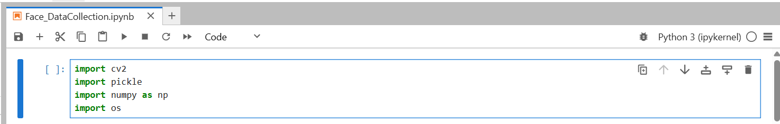
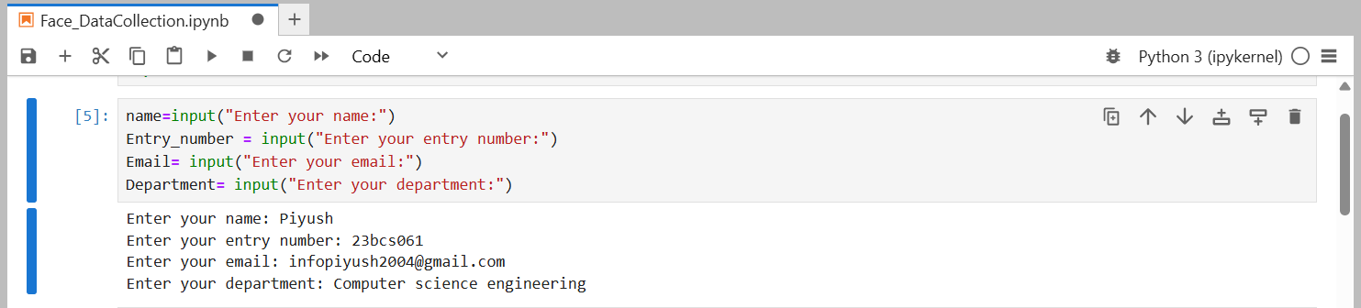
Work Done /Progress
I have imported all necessary libraries and modules.
Here I am collecting all necessary data from the users.

Slide 8
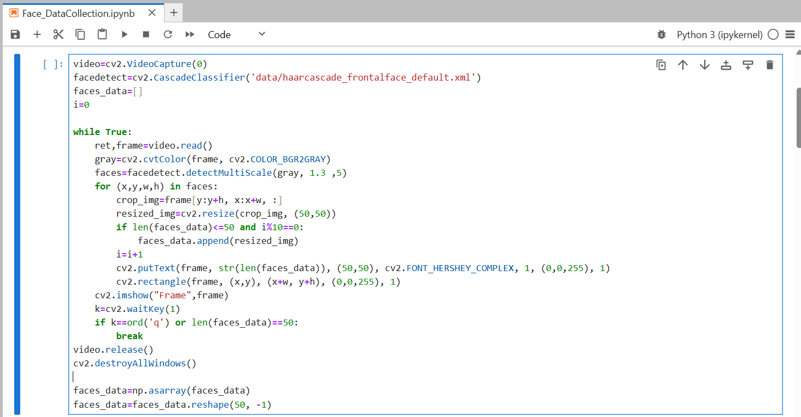
User Facial detection & data collection
Code snippets for Collecting Face data of the users.

Slide 9
Here, I have used the Haar Cascade classifier for face detection with the help of the
pre-trained classifier file “haarcascade_frontalface_default.xml’’ . The classifier is
trained with many positive images (with objects) and negative images (without objects).
With the help of the detectMultiScale() function, we find four parameters: ‘x’ and ‘y’, which are the coordinates of the upper-left corner and ‘w’ and ‘h’, are the width and height of the detected face in the frame.
Draws a rectangle around detected face, using the coordinates (x, y) (upper-left corner) and (x+w,y+h) (lower-right corner).
Draws the number of detected faces as text on the frame at position (50, 50).

Slide 10
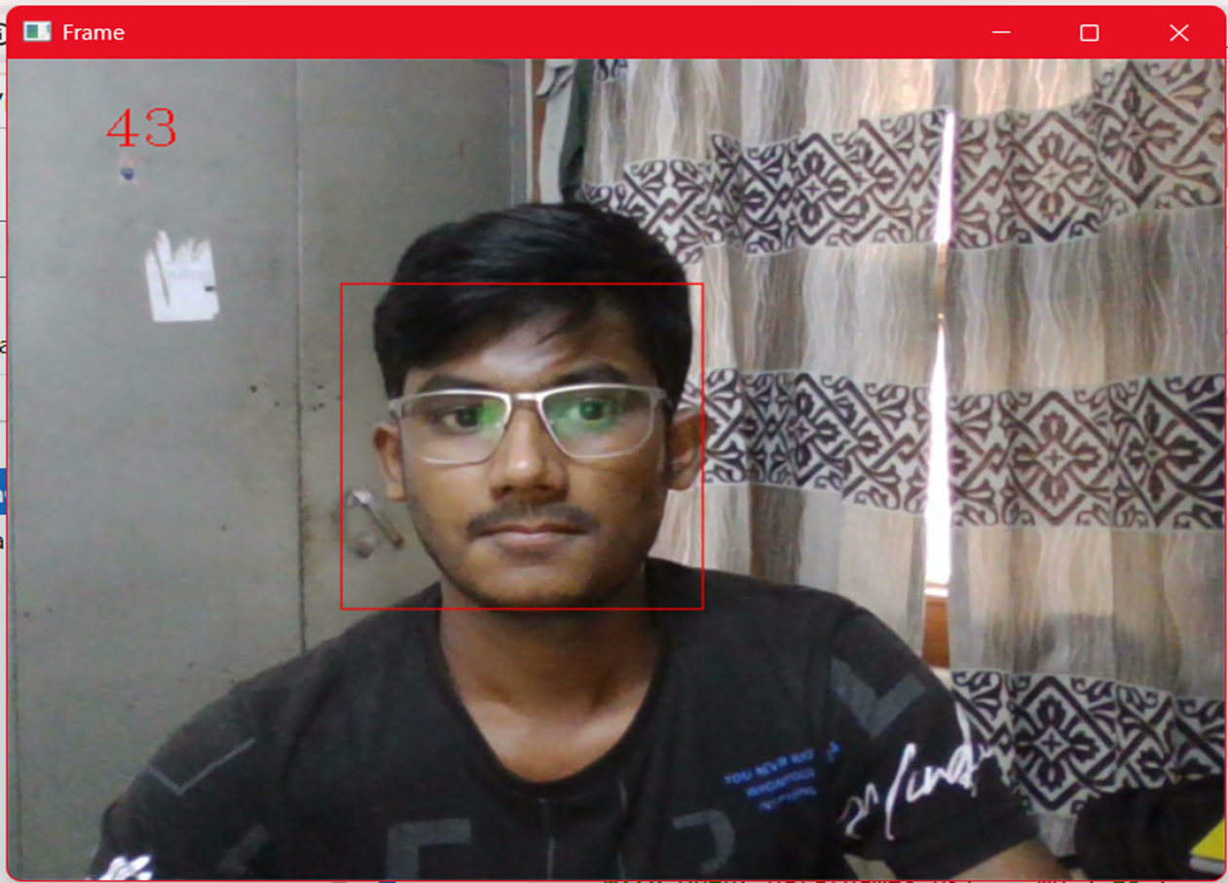
Here I am detecting face of the users.

Slide 11
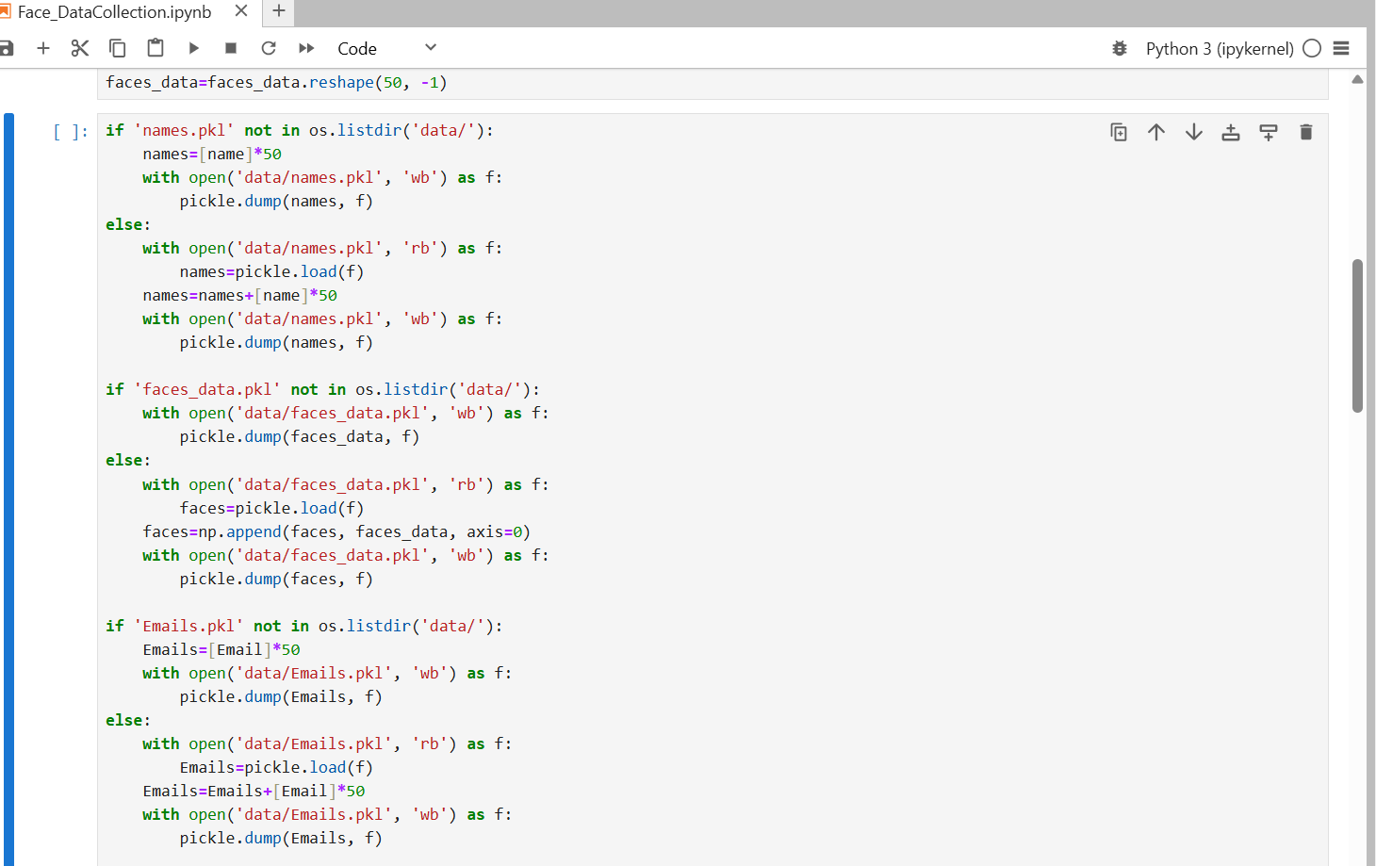
User database creation

Slide 12
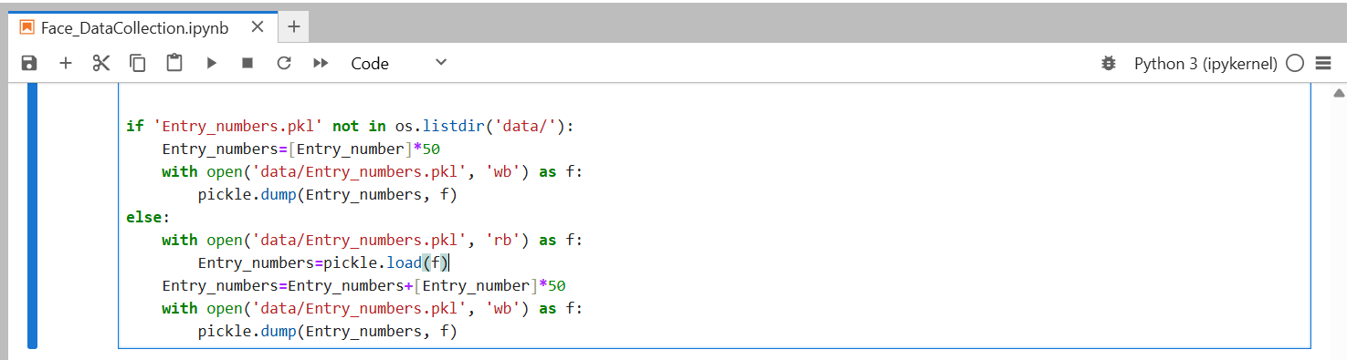
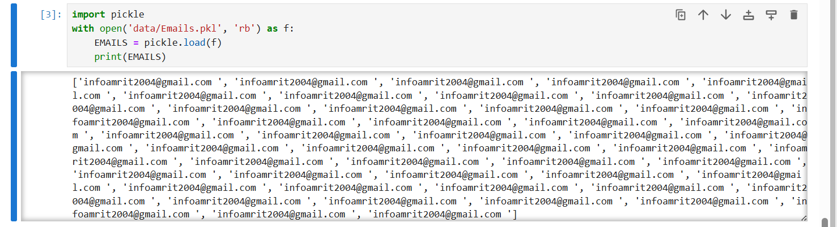
Here I am storing all collated data from users in pickle file..

Slide 13
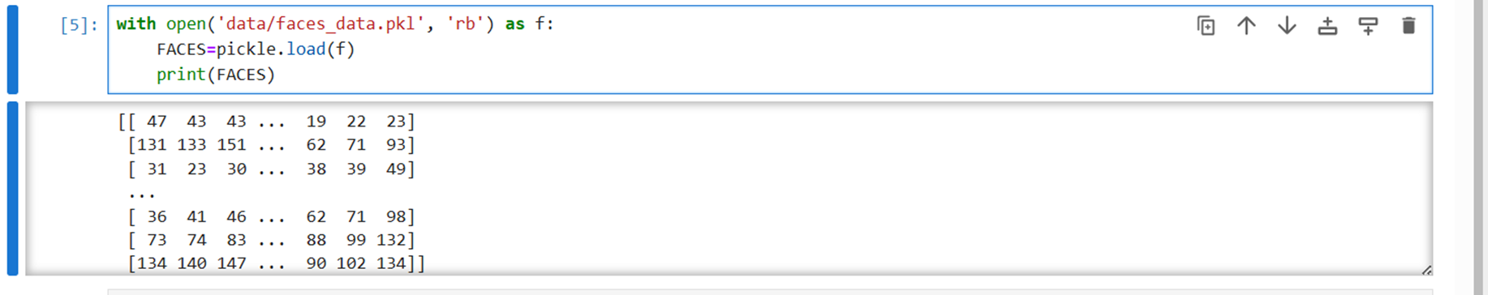
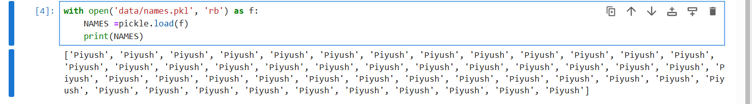
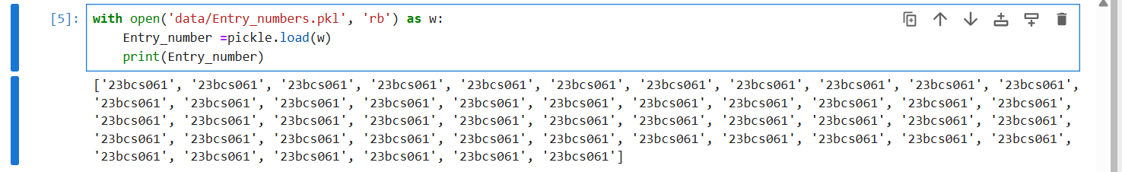
Data store inside the pickle file.

Slide 14
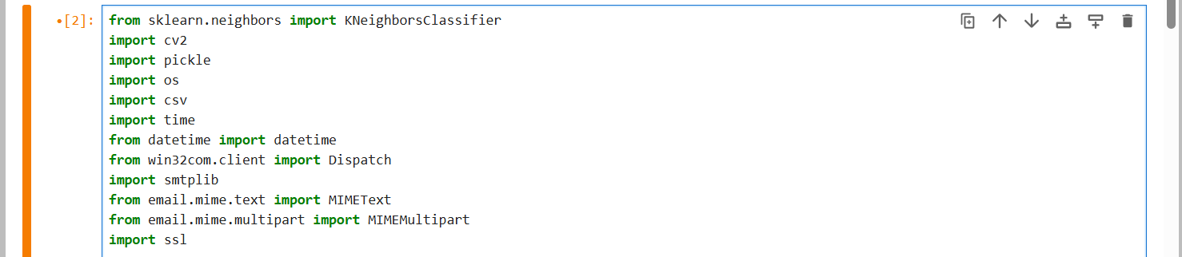
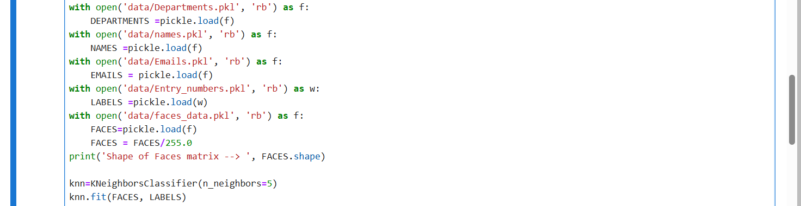
Training Model
Imported all necessary libraries and modules ..
Here, I loaded all data and train the KNN model with FACES as training data and
LABELS(entry-no) as labelled class.

Slide 15
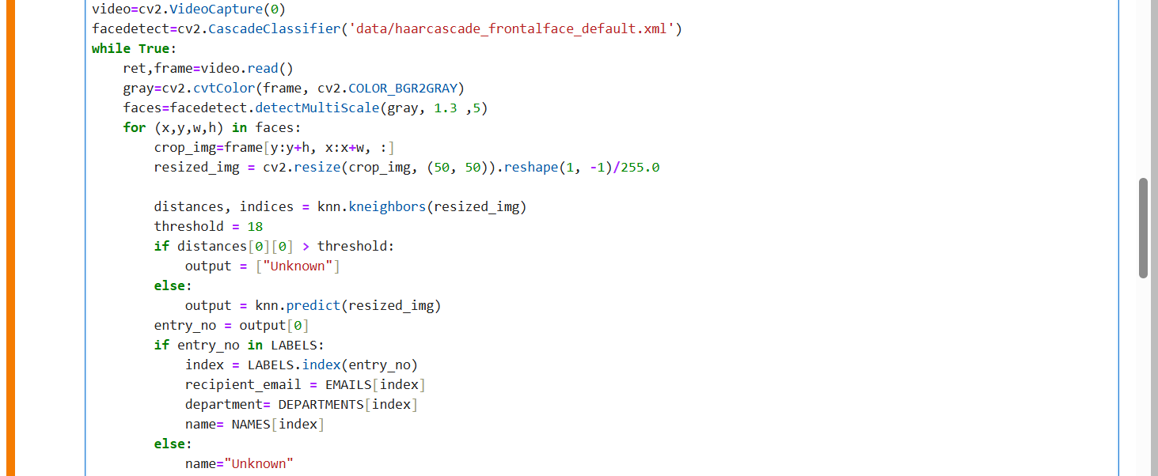
Face Recognition
Here, I am recognizing the user’s face and retrieving all of that user’s stored data.

Slide 16
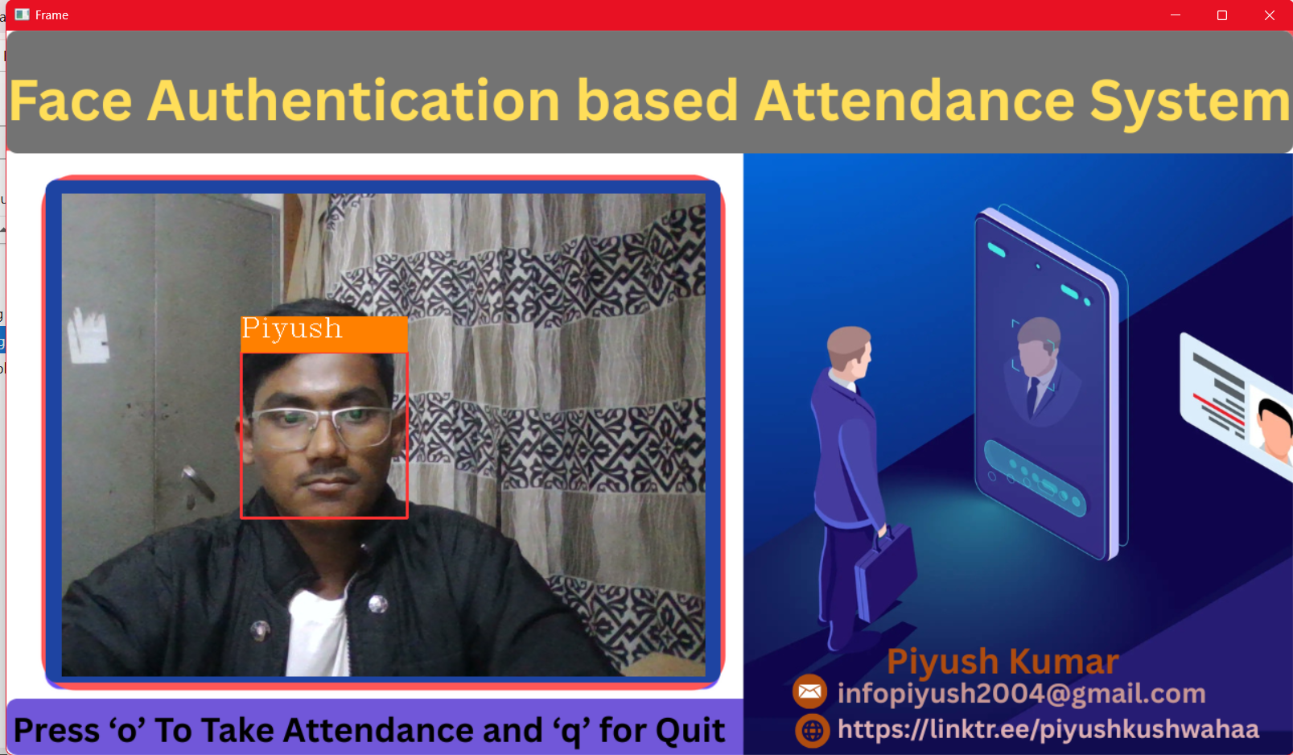

Slide 17
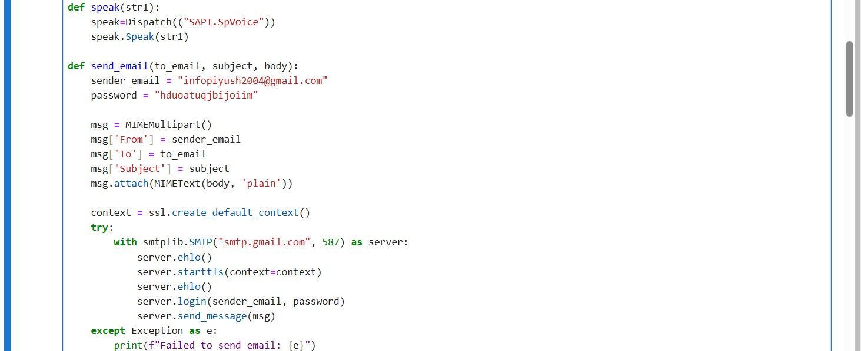
Email & Voice Setup
Function to generate voice (text‑to‑speech) and send email notifications

Slide 18
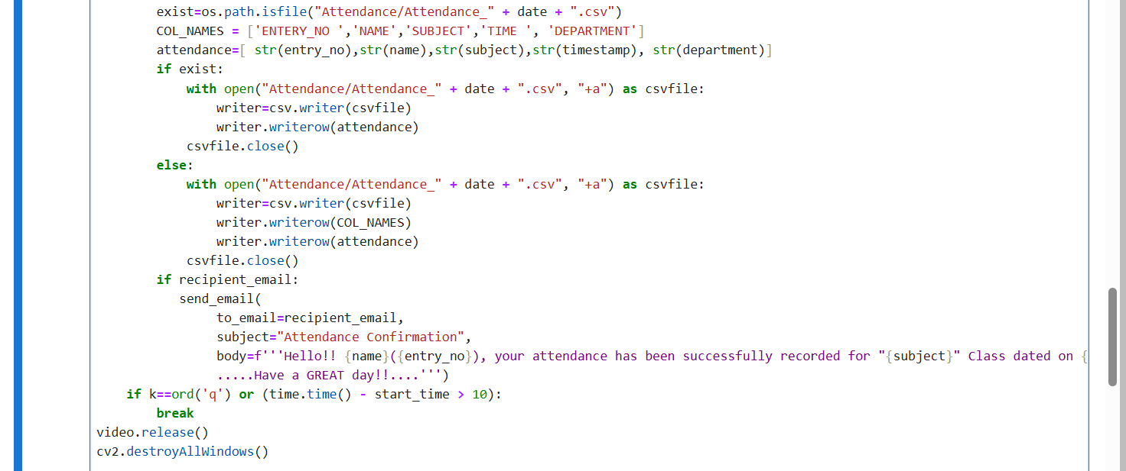
Attendance Marking & Confirmation
Here, I am marking attendance and sending email to the users .

Slide 19
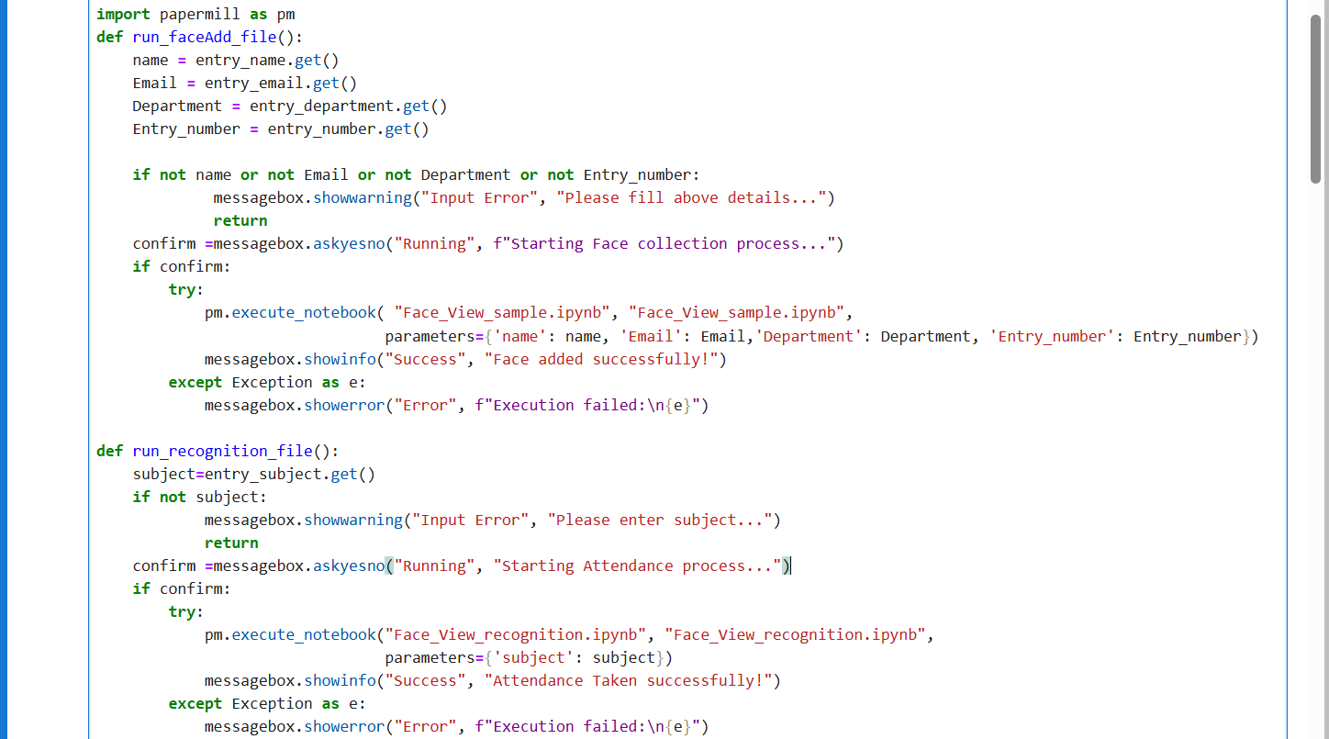
Graphic User Interface(GUI)
Function for running jupyter notebook files..

Slide 20
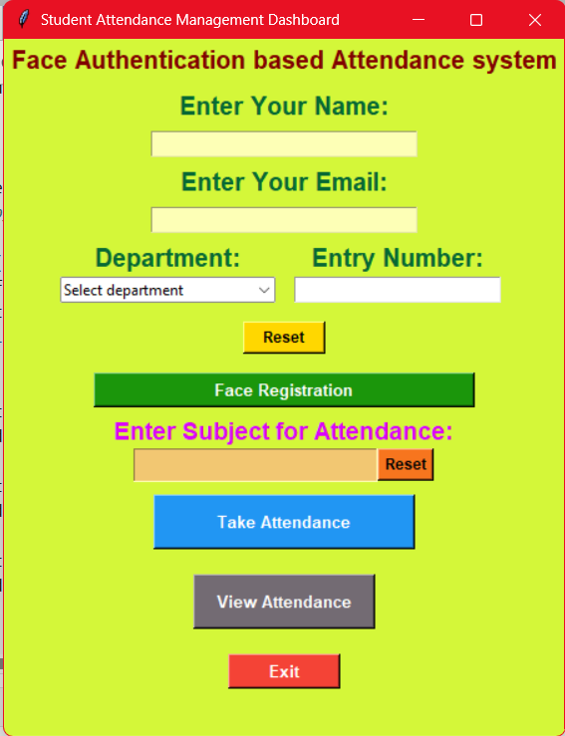
Attendance
Dashboard

Slide 21
Future work
Till now, I have completed all steps and executed successfully according to the synopsis submitted by me.
Incorporation of deep learning–based face recognition models (e.g., CNNs, FaceNet) to improve accuracy and robustness against pose and occlusions.
Integration with cloud platforms for centralized database access, enabling remote attendance monitoring and scalability for large institutions.
Mobile application support for on-the-go attendance marking and notifications.
Advanced liveness detection techniques to prevent spoofing attacks using photographs or videos.
Real-time analytics dashboard with AI-powered insights on attendance trends and irregularities.

Slide 22
How I overcome challenges ?
I use Google, YouTube videos, and blogs related to computer vision and face
recognition for handling challenges.
Conclusion
The Face Authentication–Based Attendance System successfully demonstrates an automated, efficient, and secure method for attendance management using facial recognition technology. By integrating Haar Cascade for accurate face detection and K-Nearest Neighbour (KNN) for robust face recognition, the system eliminates common drawbacks of manual and contact-based attendance methods such as proxy attendance, time consumption, and hygiene risks. The implementation confirmed high accuracy rates (above 95%) under varying real-world conditions including lighting and facial expressions. The system's intuitive user interface, streamlined database management, and real-time processing capabilities contribute to operational efficiency in educational purpose.

Slide 23
References
https://www.geeksforgeeks.org/python/face-detection-using-cascade-classifier-using-opencv-python/
https://thepythoncode.com/article/create-a-facial-recognition-system-in-python

Slide 24
Thankyou…….

